Slide 1
Personalized Diet Recommendation System in Healthcare using Predictive approaches
Guide by:- S.Irene
Piyush soni
Prn no. 22960825031

Slide 2
Introduction
Wide variety of ingredients, cultures and personal tastes makes decision about what to eat a great problem.
Many diseases that were previously thought as hereditary are now seen to be connected to biological disfunction related to nutrition.
Being healthy and eating better is something the vast majority of the population wants and doing so usually requires great effort.
The working prototype accomplishes a Personalized Diet Recommendation System with integration of Machine Learning Algorithms to recommend the right food at right time and with the right nutrition, calories, fat etc.

Slide 3
Objective
To establish working prototype of a Personalized Diet Recommendation System

Slide 4

Existing System
The existing working model of the Diet Recommendation System gives recommendations concerning food based on user inputs in general life style on regular food timings.
The food is recommended based on the user habits of food intake at a particular term according to his/her tastes.

Slide 5
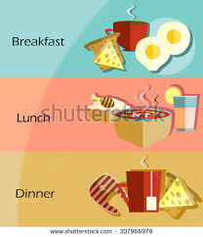
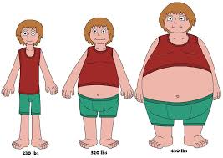
Issues
The issues that are being faced by the current working model is it does not facilitate a user with the food classification based on the food timings on a daily basis other than general food timings
The existing system struggles to provide a weight gain/loss scheme to a user based on his long term food habits

Slide 6
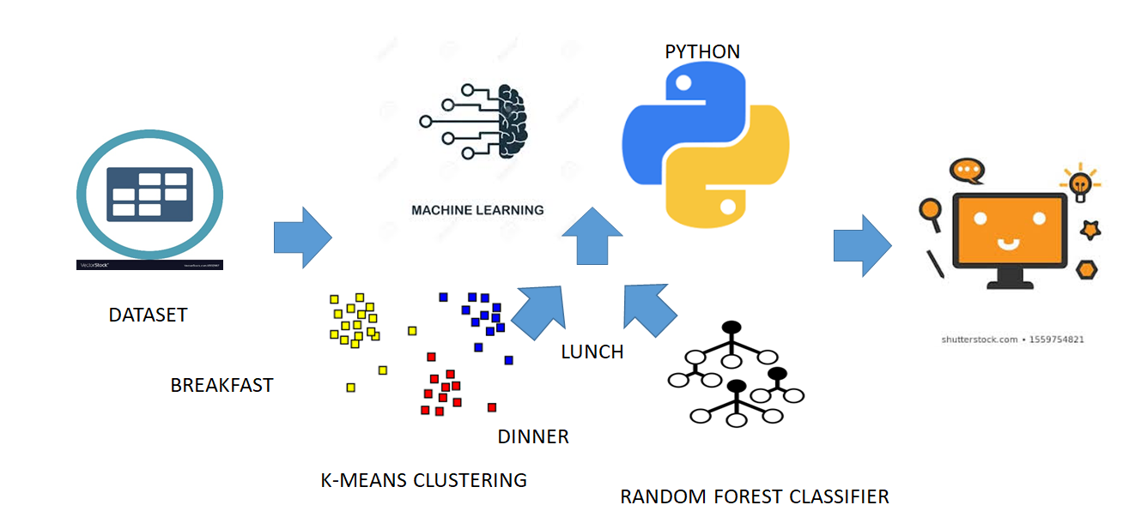
System Architecture

Slide 7
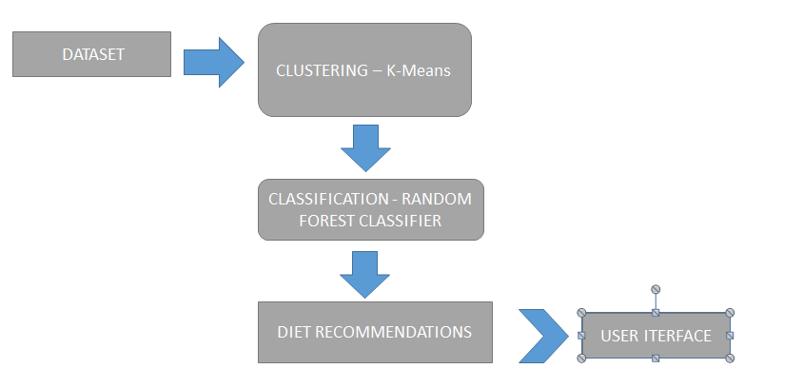
SYSTEM WORKFLOW

Slide 8
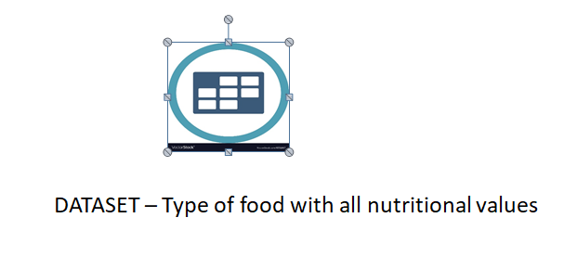
MODULES
Dataset:

Slide 9
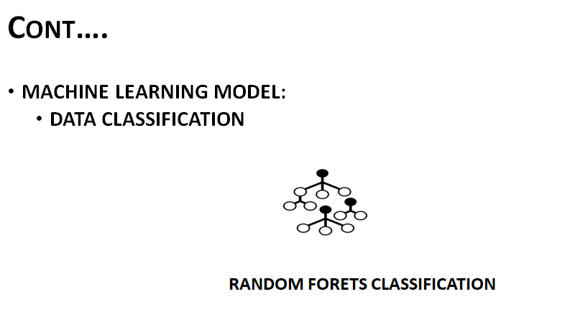

Slide 10
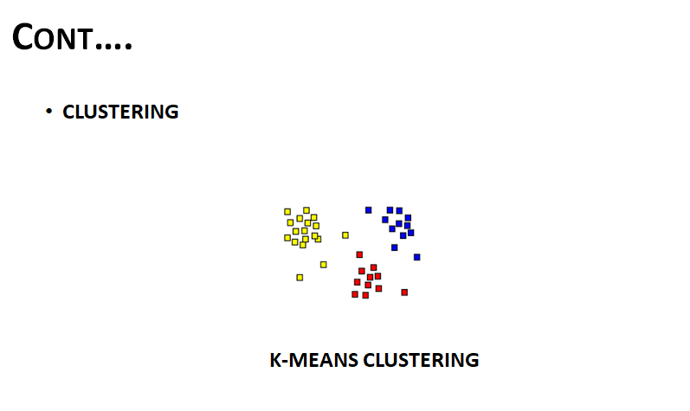

Slide 11
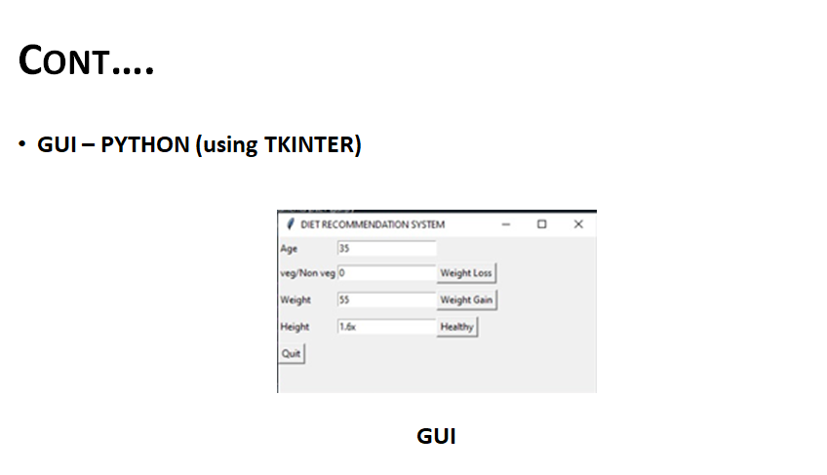

Slide 12
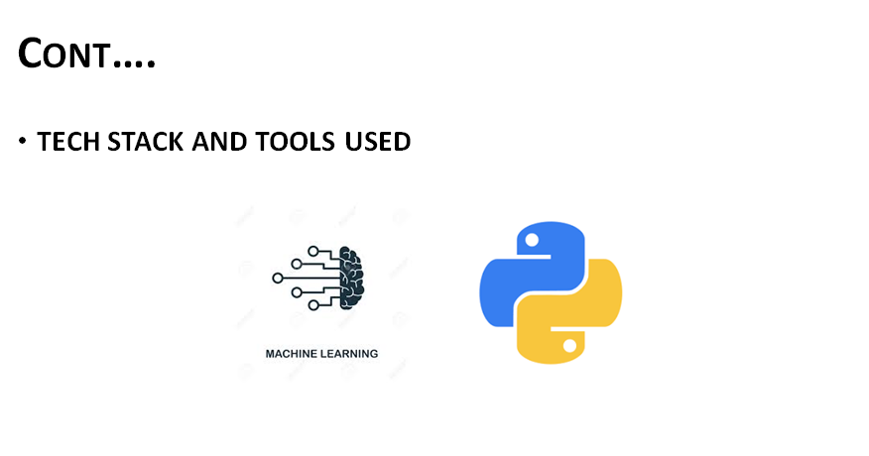

Slide 13
Implementation Procedure
For training of the system , the initial process involves the segregation of food items depending upon the meal for which they are consumed i.e Breakfast , Lunch and Dinner.
The clustering of various nutrients depending upon which are essential for the weightloss , weightgain and healthy is performed.
After the clustering is performed , using Random Forest classifier , the nearest food items are predicted which best suites for the appropriate diet.
As part of user interface , the inputs needed from the user are Age , Height , Weight and what the purpose for which the diet is required.
Depending upon it , from the appropriate clustering , specific food items are classified and recommended to the user.

Slide 14
Result
A working prototype of a Diet Recommendation System is established.
The module works on the basis of K-Means Clustering and Random Forest Classification Algorithms.
Tkinter based GUI is implemented.

Slide 15
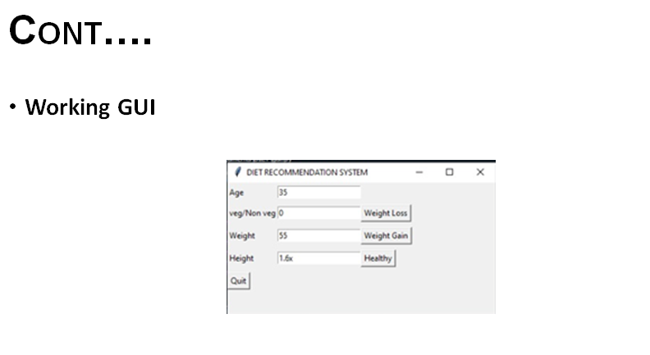

Slide 16
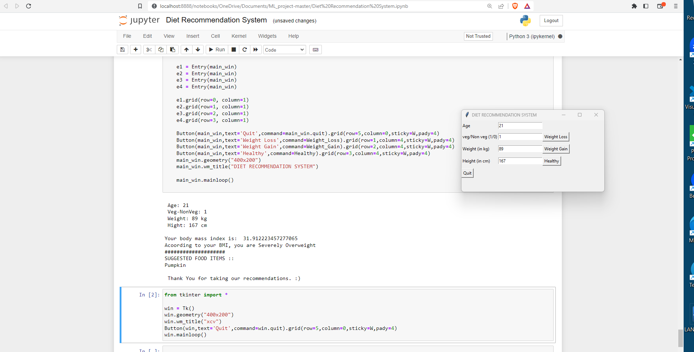
WORKING MODULE:

Slide 17
Cont….
Diet is recommended based on the user’s input and also the desired food list is displayed.
BMI’ is also calculated and taken into consideration.
Weight Loss/Gain/Healthy diet category is also predicted.

Slide 18
Future scope:
The module can be implemented as a cloud based application. Packaged as a single entity, ready for production environment deployment .

Slide 19
Conclusion
A Diet Recommendation System is implemented with the working functionalities like:
Desired food list prediction.
Weight category prediction.
BMI Calculation.
Health is vital for an individual and can be achieved with this working module. Thus making life healthy.

Slide 20
✔ Thank You 🙂

